Slide 1
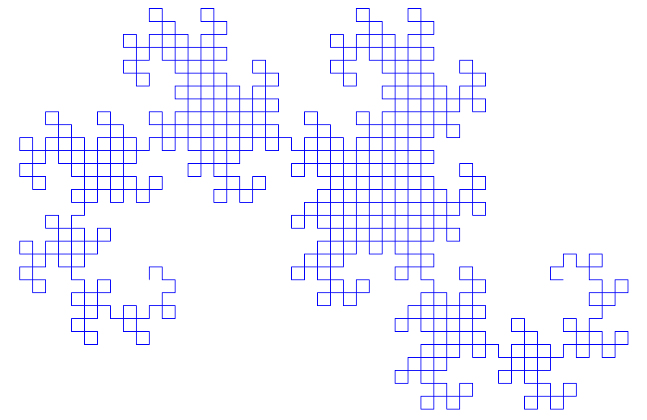
Feature Preserved Morphing using Delaunay Triangulation
Instructor:
Dr. Anukriti Bansal
Team Members:
Ansh Mittal - 17ucs028
Anshul Jain - 17ucs029

Slide 2
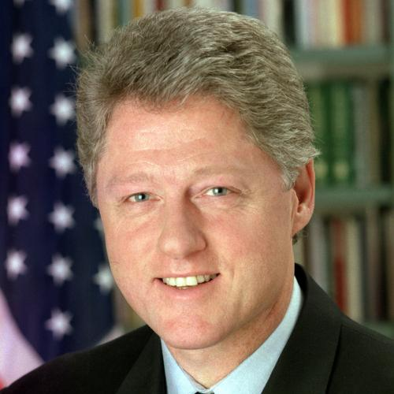
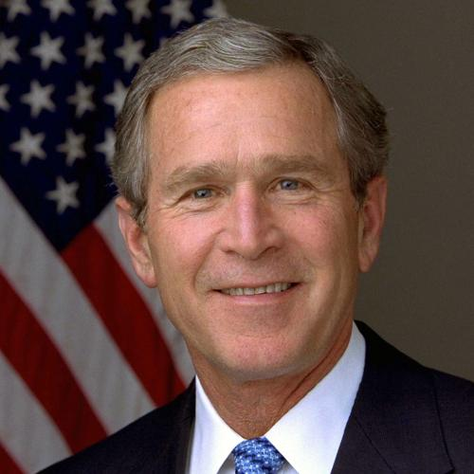
Input Images
Input Images
Initial Image (500*500)
Final Image (500*500)

Slide 3


Images with Control Points
Initial Image
Final Image

Slide 4
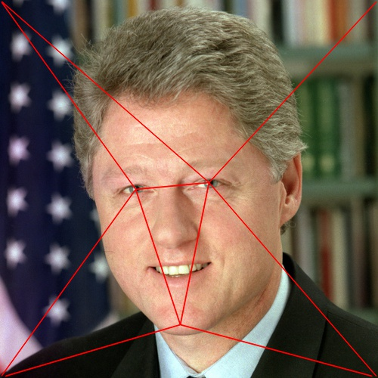

Images with Triangulation
Initial Image
Final Image

Slide 5

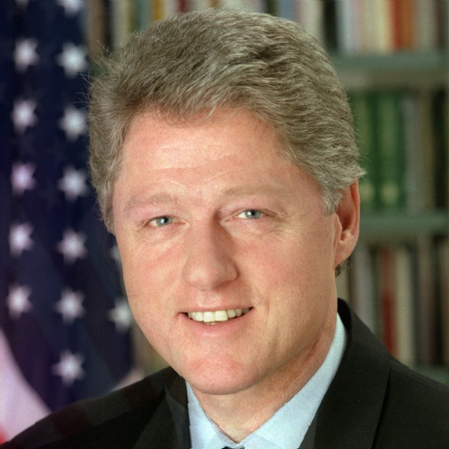
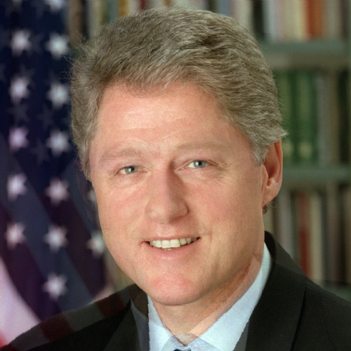
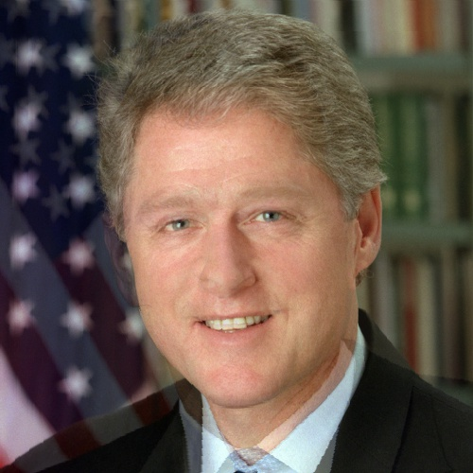
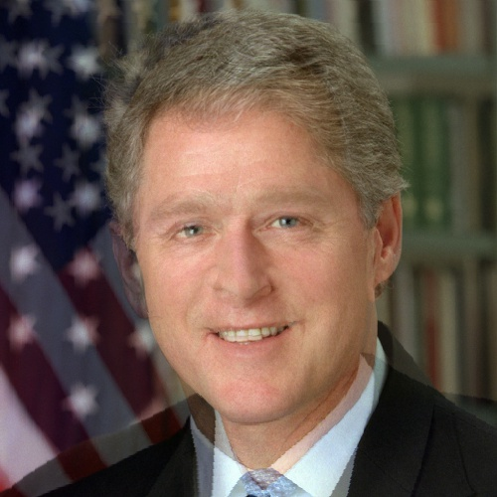

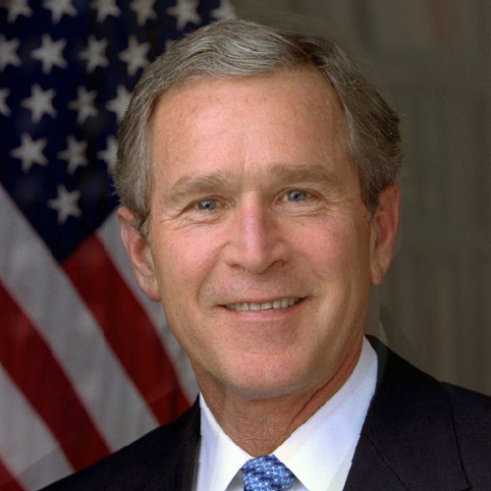
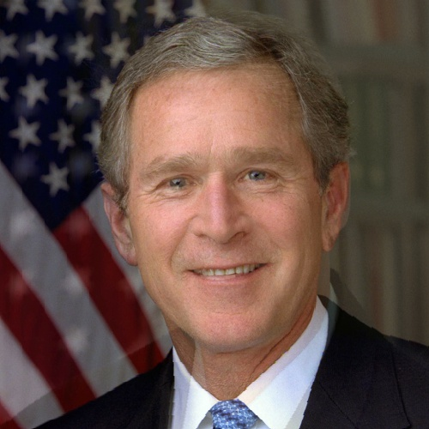
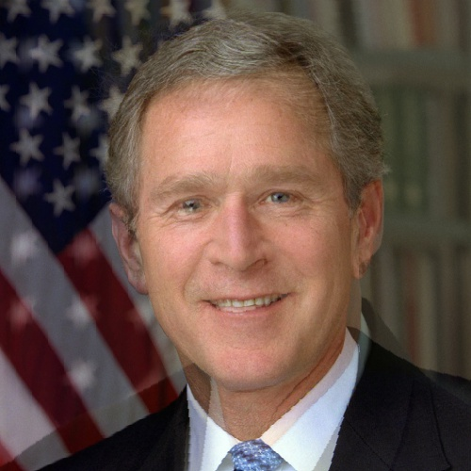
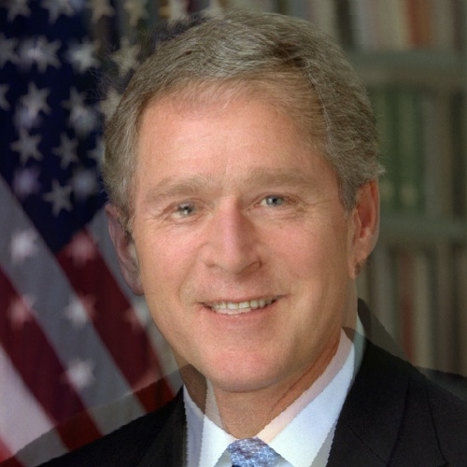
Intermediate Frames

Slide 6
Thank You

